Slide 1
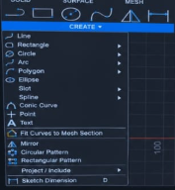
Ex.No.-1.1-Design and Draft the given 2D Sketches in modelling software.
AIM
To sketch the given drawing with dimensions using fusion 360 tool.
REQUIREMENTS
1. Autodesk fusion 360
2. Windows 10
3. 16 GB of RAM (integrated graphics recommend 2 GB or more)
4. 2.5 Mbps or faster download; 500 Kbps or faster upload
PROCEDURE
1. Open New File: Initialize a blank design project in the modeling software and select the Sketch tool icon.
2. Select Sketch Plane: Choose the appropriate reference plane (XY, YZ, or XZ) to begin drawing.
3. Draw Geometric Shapes: Use foundational sketching tools like Line, Circle, Rectangle, or Arc to build the initial 2D geometry.
4. Modify & Edit Sketch: Apply modification tools such as Fillet, Chamfer, Trim, Extend, or Offset to refine and clean up the sketch.

Slide 2
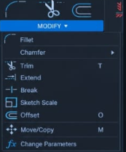
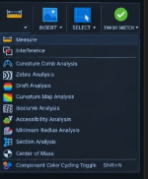
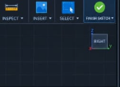
5. Inspect & Verify Dimensions: Use the Inspect / Measure feature to verify the dimensions and ensure exact geometric accuracy.
6.After finishing the sketch use finish sketch option to finalize the sketch.
7. After finishing the sketch switch to drawing mode to plot the sketch in ISO standard.

Slide 3

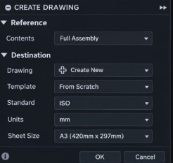
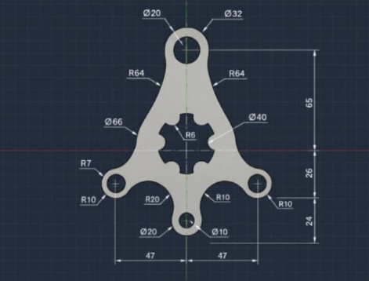
SKETCHS

Slide 4
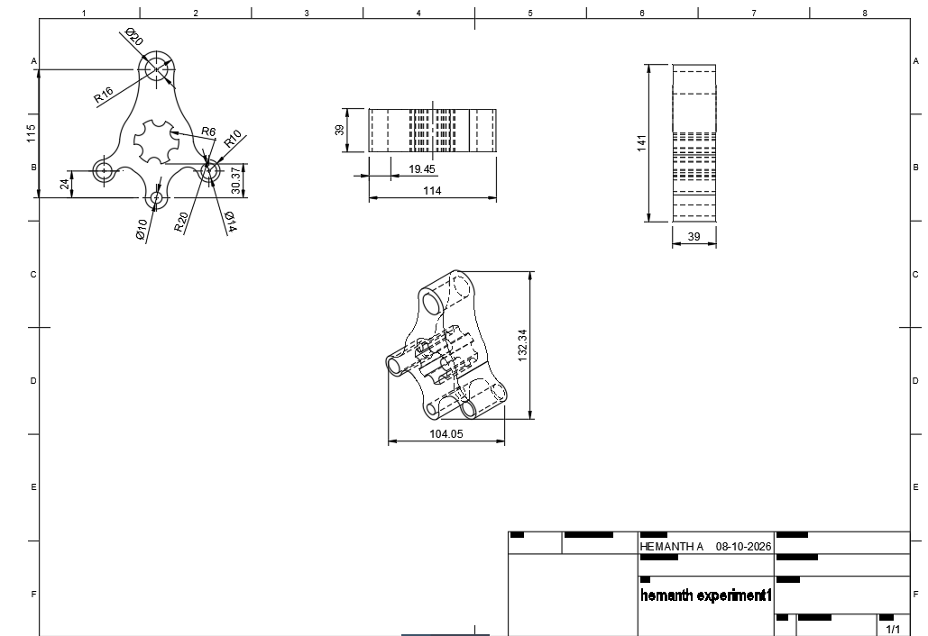
OUTPUT
RESULT
Thus the given sketch is drawn and drafted using fusion 360 tool.

